Slide 1

AdvTech
TVET COLLEGES TRAINING MANUAL

Slide 2
QUICK MENU
Download Timetable Application Software
Software Installation
Importing data from ITS
Navigating to the Welcome Screen
The Grid
Working with Venues
How to Save
Built in Timetable alerts
Assigning Subjects under Periods Tab
Assigning Subjects under Ties Tab
Assigning subjects in the Overview
Mid-year teacher replacements or name changes
Looking after the Data: How to Save
Looking after Data: How to backup
Compilation of Timetable
Edit Period succession in the Timetable
Placing all periods of a specific subject on 1 day
Blocking Admin or other periods
Build a Timetable
Print the Timetable
How to Export information to ITS

Slide 3
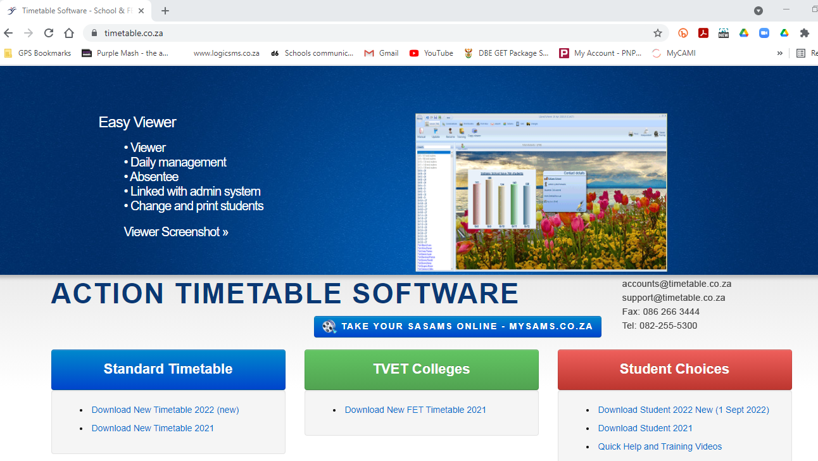
GO TO www.timetable.co.za

Slide 4
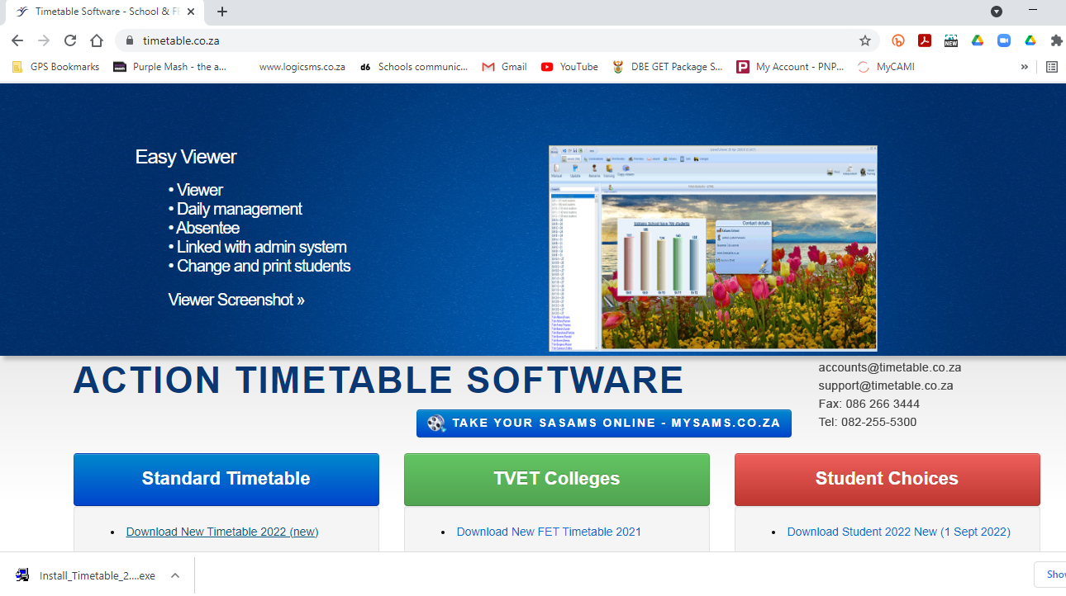
Select the most recent software link
Double click on the link
Download will show in bottom left corner

Slide 5
DOUBLE CLICK ON THE DOWNLOADED FILE
The installation process will start
BACK TO MAIN MENU

Slide 6
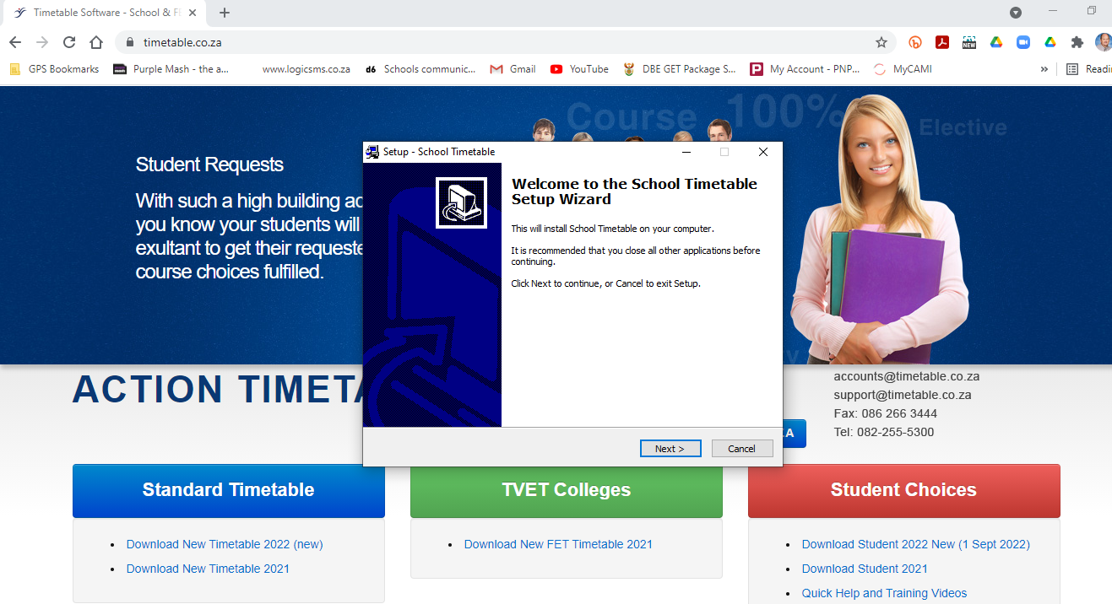

Slide 7
Do you want to allow this app to make changes to your device?
School Timetable Setup verified by USA SCHEDULER LLC
PLEASE SELECT YES
YES
NO
Click on install and allow the software to install to your hard disk drive

Slide 8
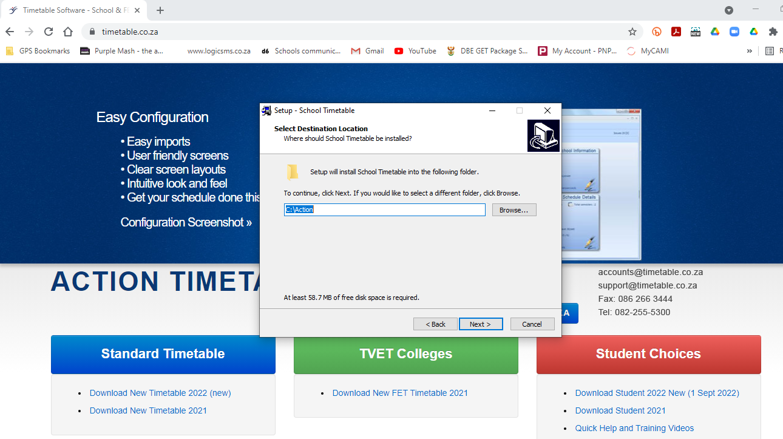

Slide 9
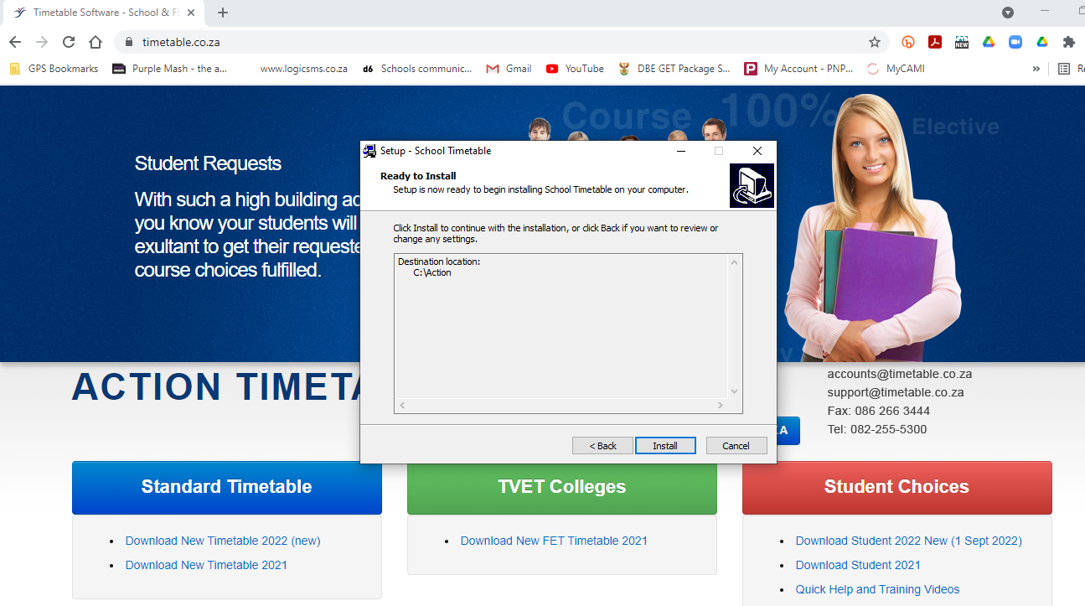

Slide 10
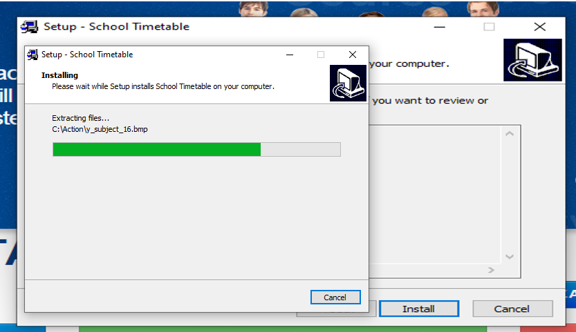

Slide 11
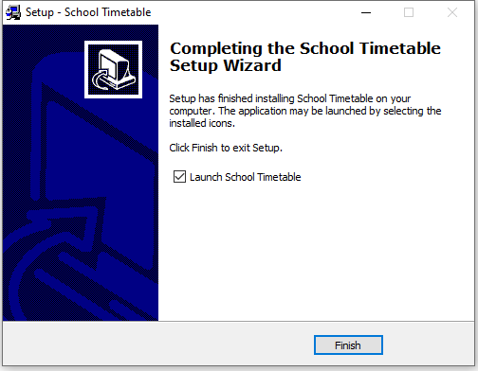
BACK TO MAIN MENU

Slide 12
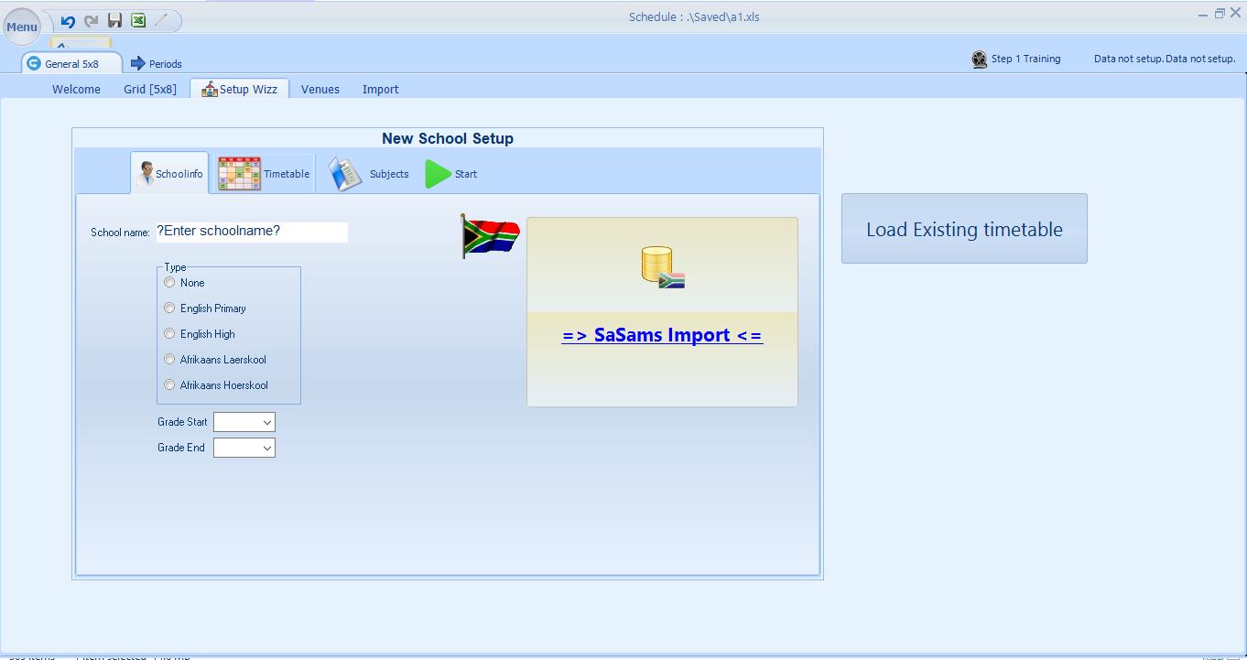
After the installation is completed, this following screen will appear.
The user will Import campus information retrieved from ITS, Serosoft or other Administrative applications under this tab.

Slide 13
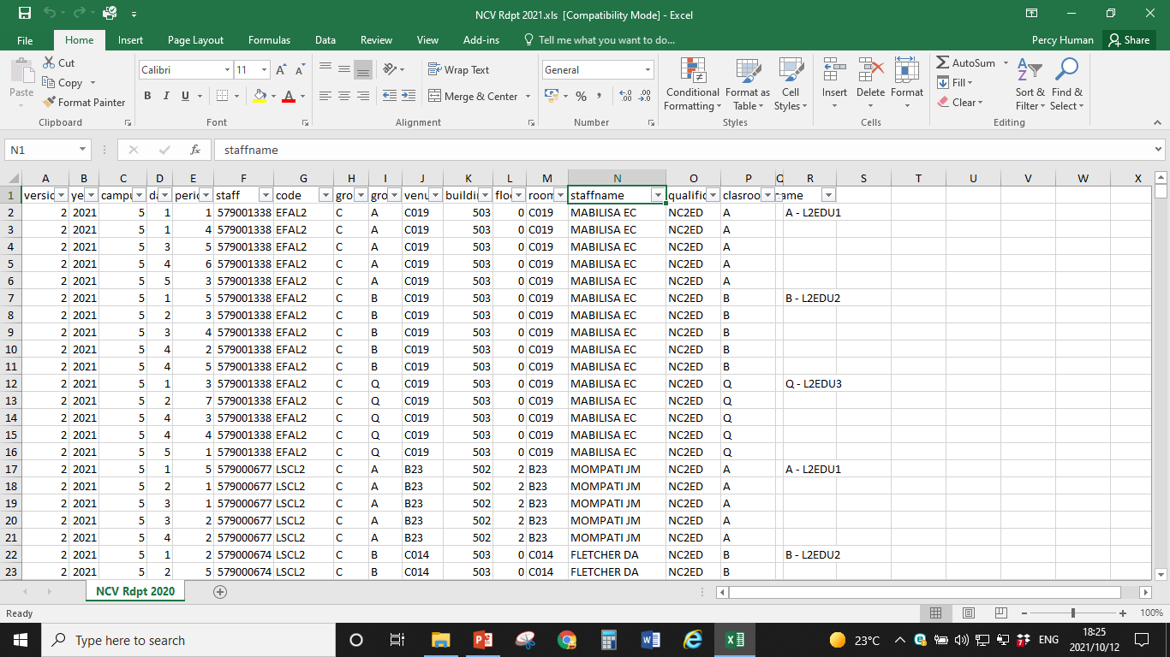
Go to the ITS File
Click on the triangle in the top left hand corner. This will select all information. It is very important to include the headers.
OR
Ctrl + A (to select all) and then Ctrl + C (to copy)

Slide 14
Select the Import Tab

Slide 15
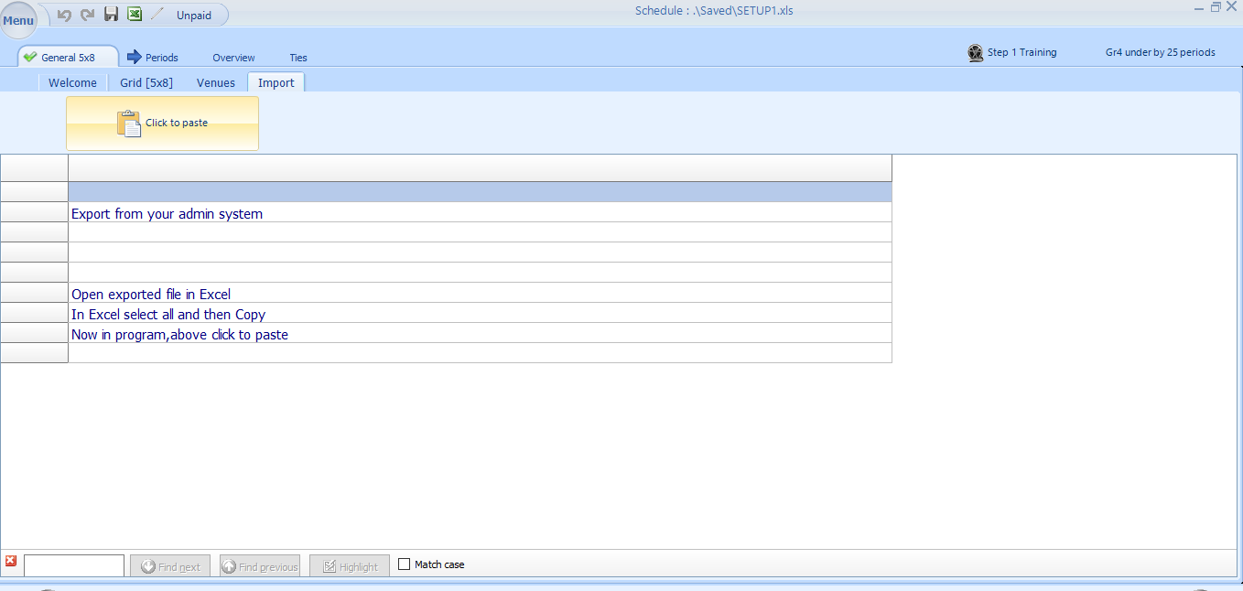
Click here to paste Campus information

Slide 16
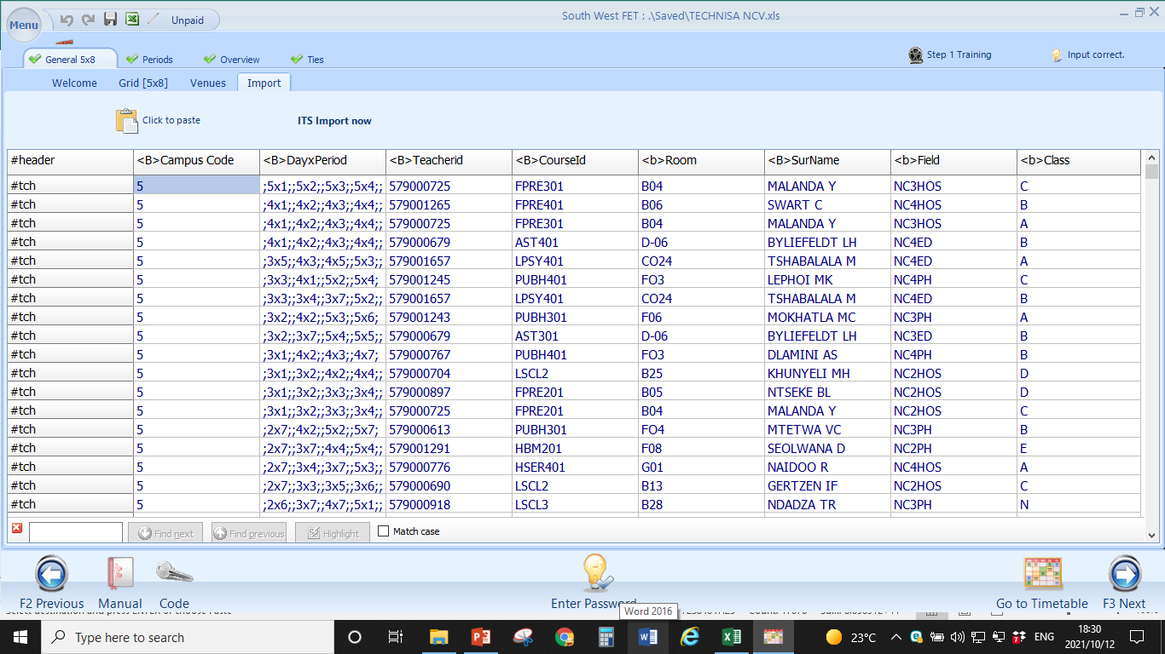
Confirm the Import by clicking the
ITS Import now

Slide 17
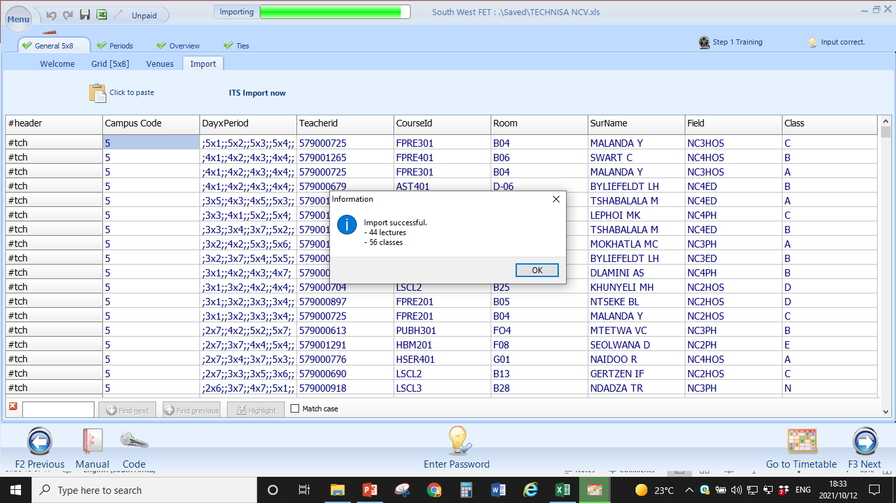
Click on OK

Slide 18
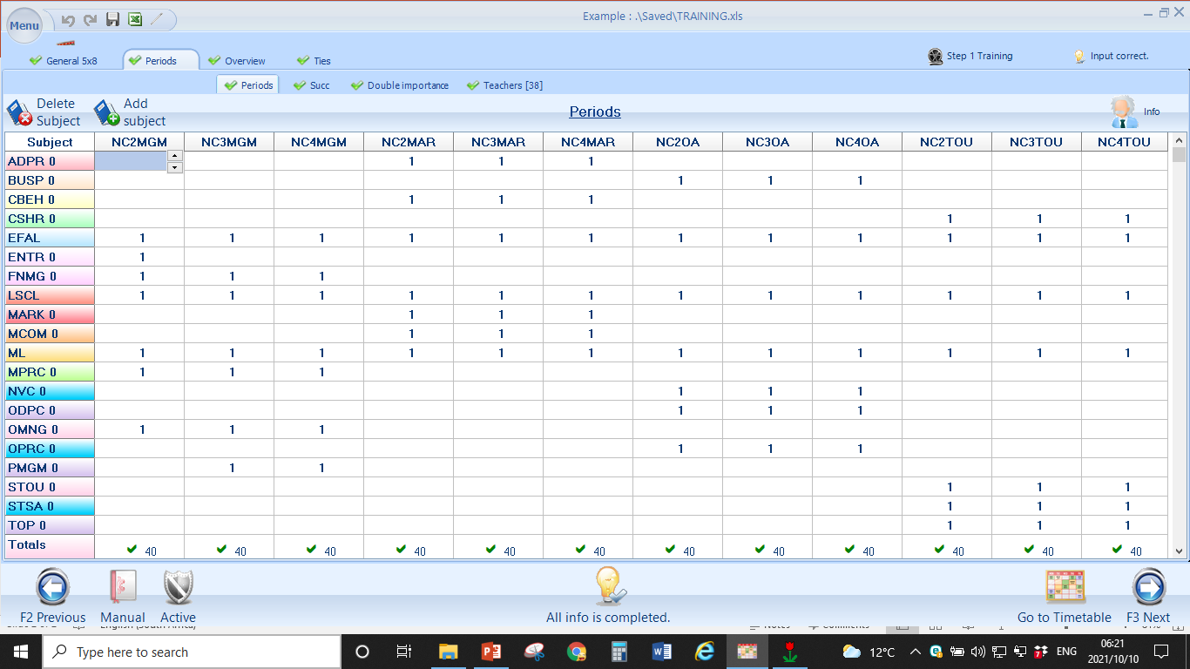
This screen will appear when the data imported correctly
You are now expected to ensure that the available information retrieved from the import is setup in such a way to suit your College needs.
BACK TO MAIN MENU

Slide 19
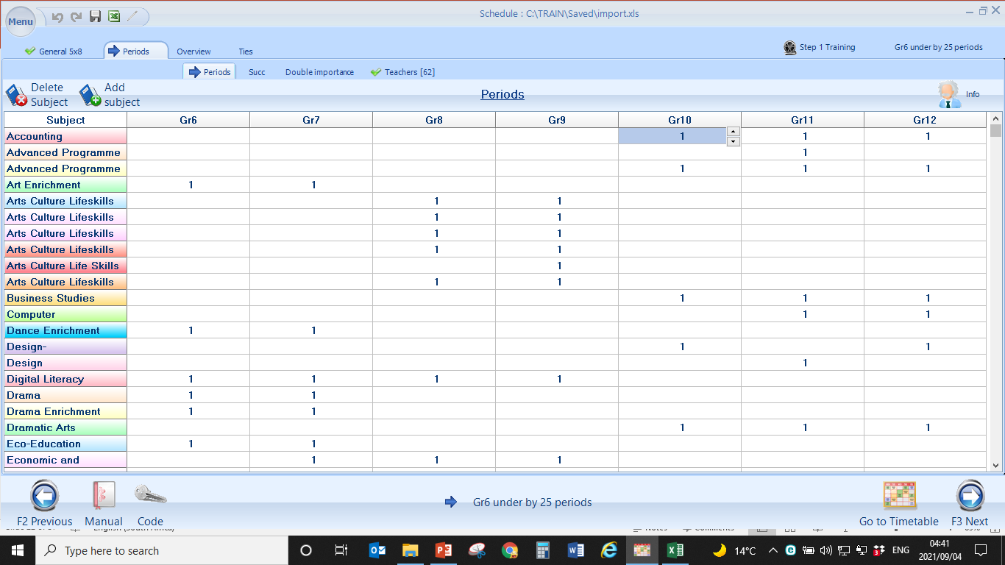
Click on the General Tab

Slide 20
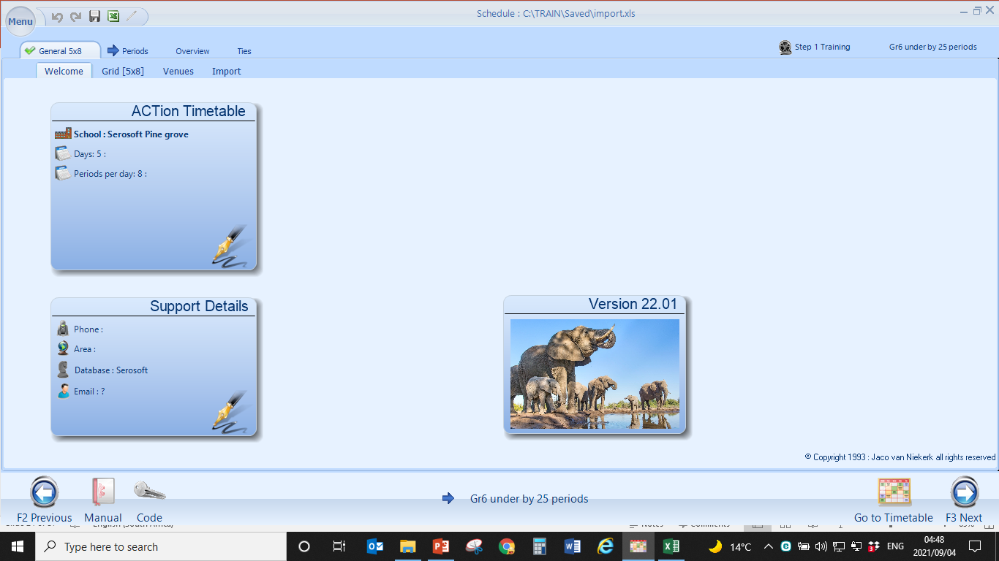
Select the Welcome Screen

Slide 21
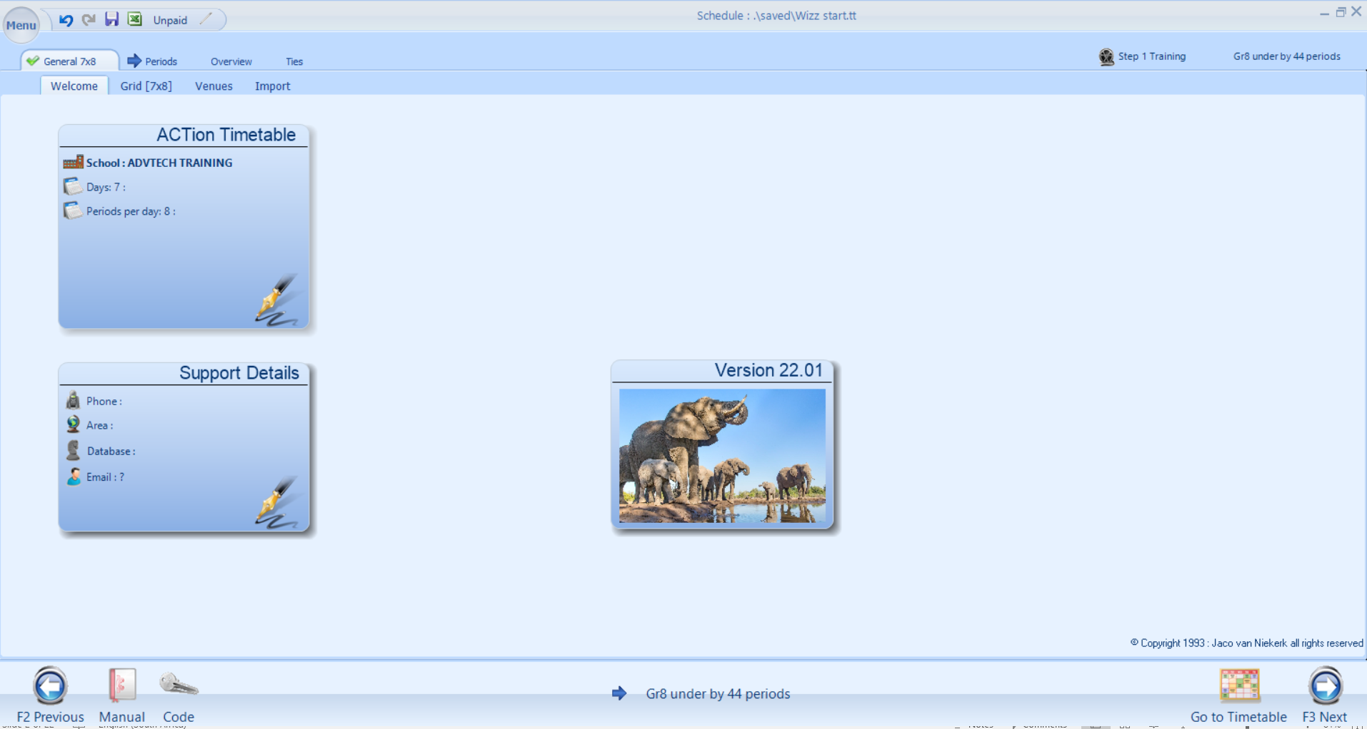
THE WELCOME SCREEN
Status information
System Information
Navigation buttons
Status information
BACK TO MAIN MENU

Slide 22
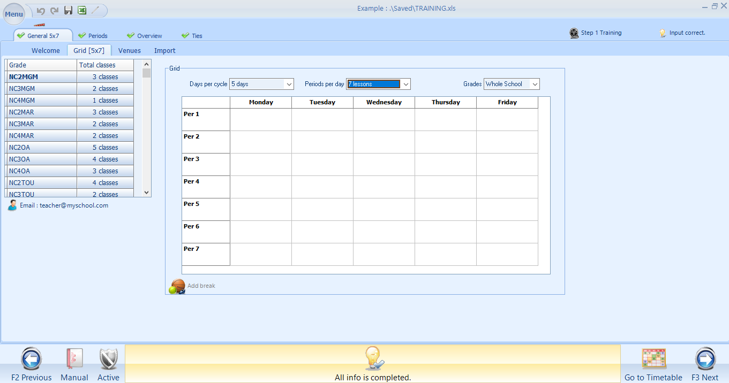
THE GRID
The Grid 5x7
Means 5 day cycle with 7 periods per day
The number of classes per course

Slide 23
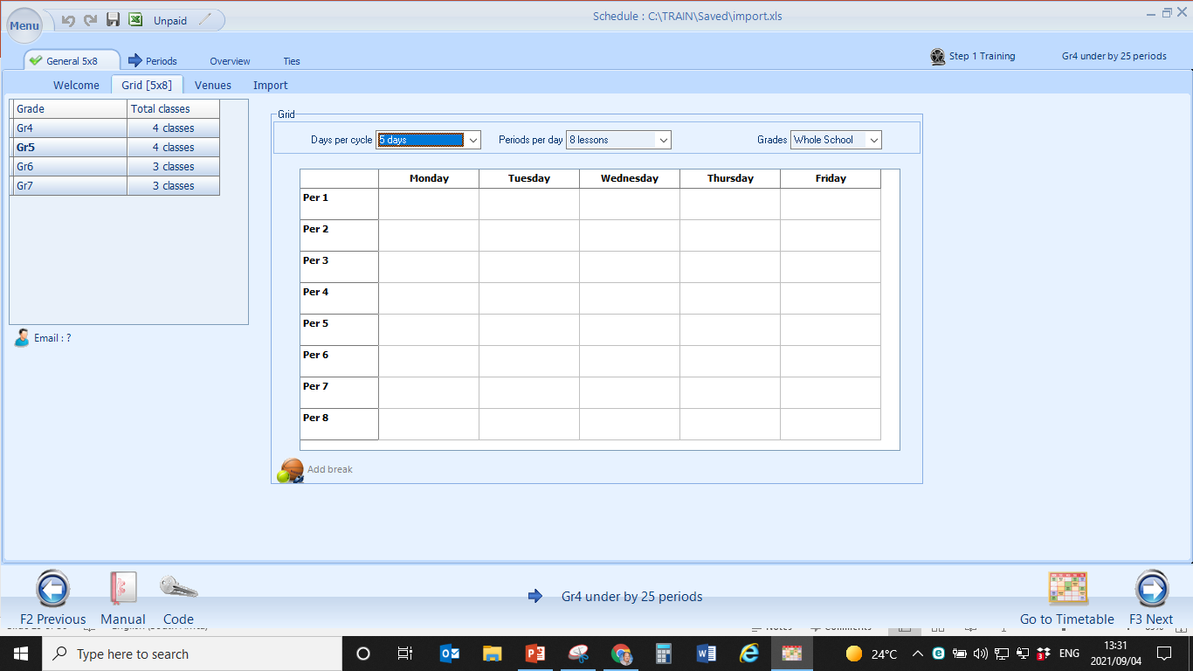
Grid 5 x 8
Means you have a
5 day cycle
with
8 lessons a day

Slide 24
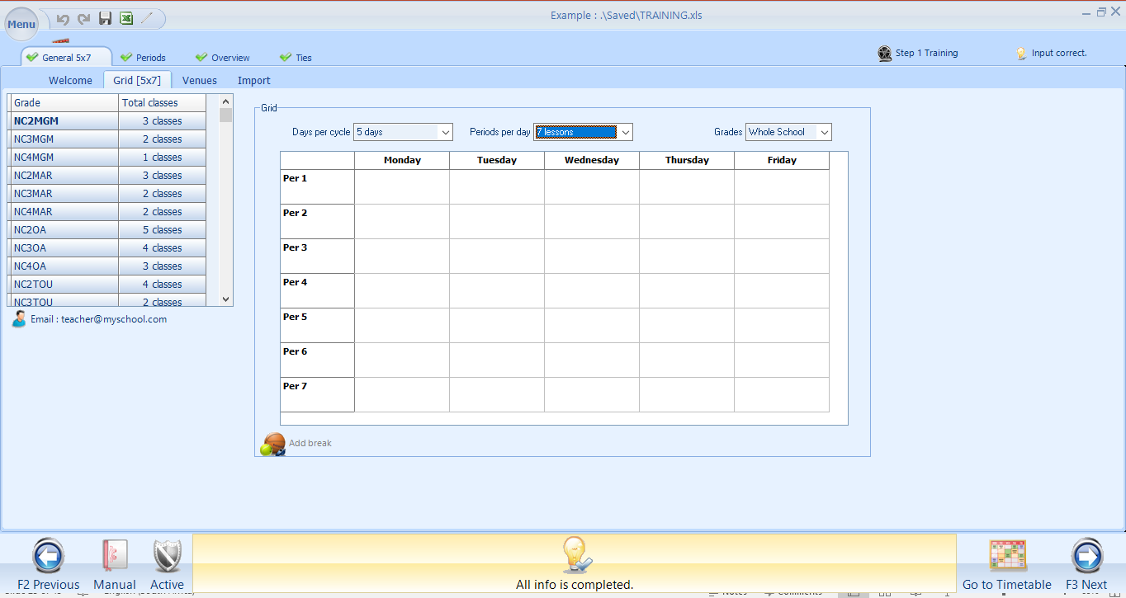
PLEASE STUDY THIS SCREEN
FREEDOM OF CHOICE The user can click and rename any information in the RED rectangles. The tabs in the GREEN rectangle / oval /circle are used for navigation. The information in the BLUE oval/circle is for information / status of progress made by the user.

Slide 25
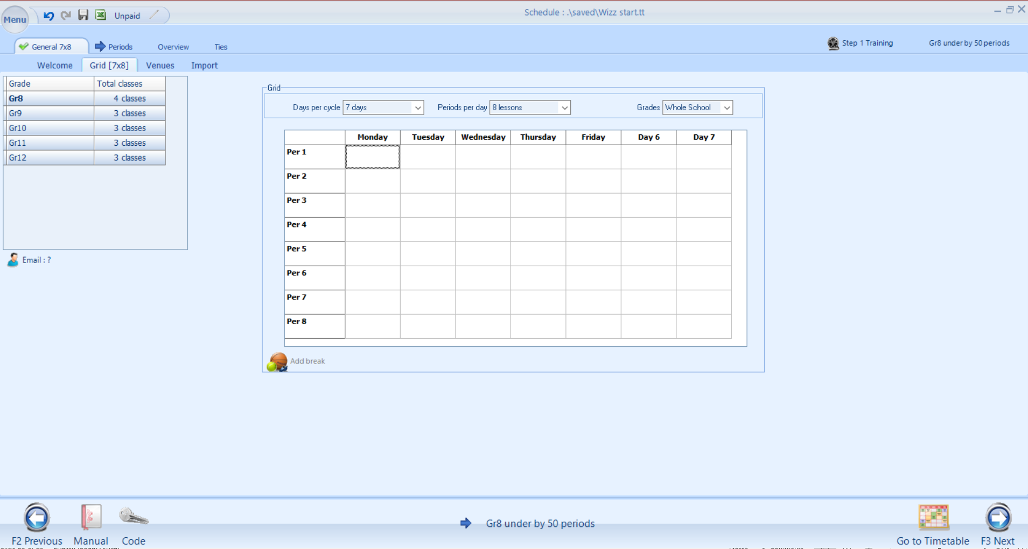
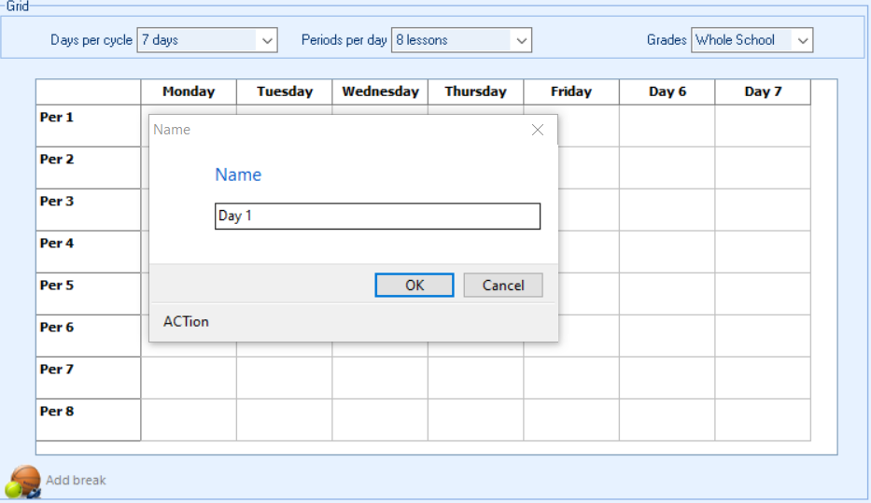
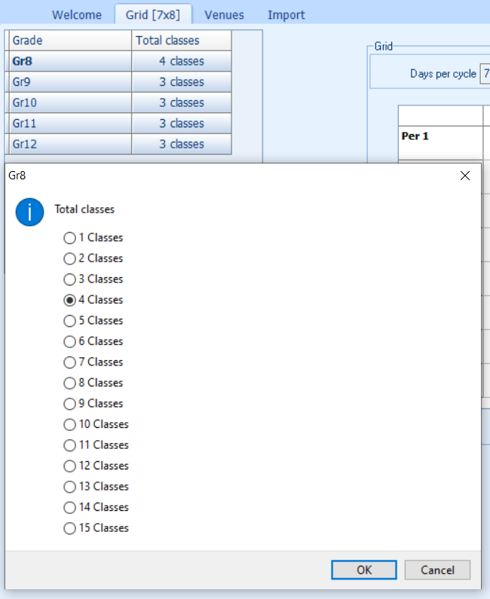
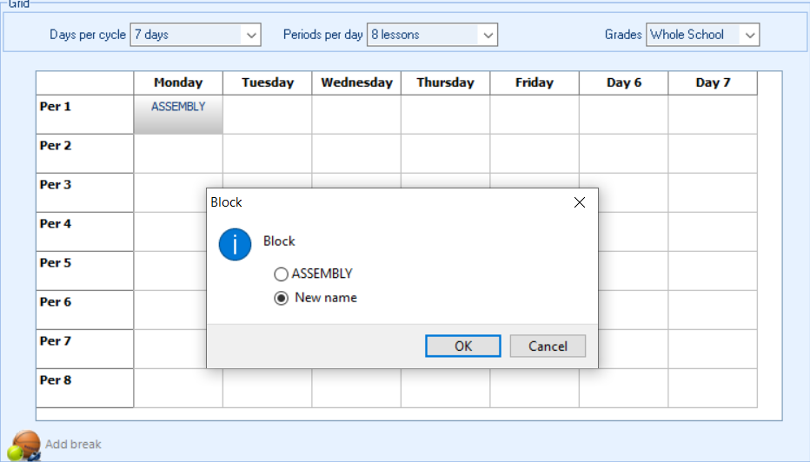
Double click and Rename days
Double click and allocate blocked periods (eg. Assembly)
Double click and change number of classes, or Rename classes
BACK TO MAIN MENU

Slide 26
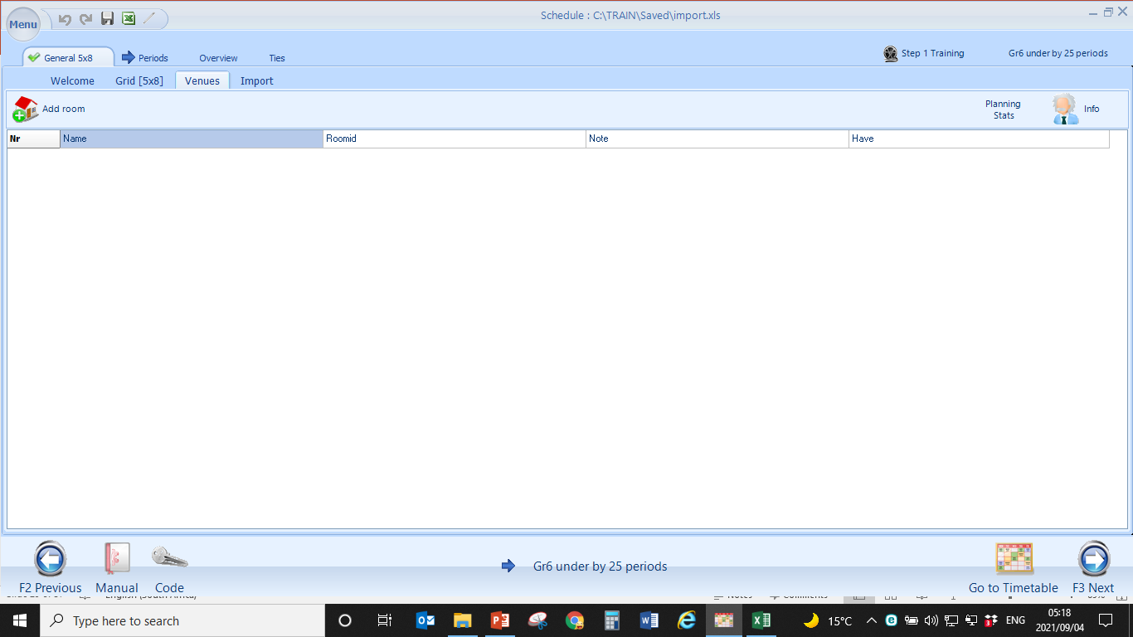
VENUES

Slide 27
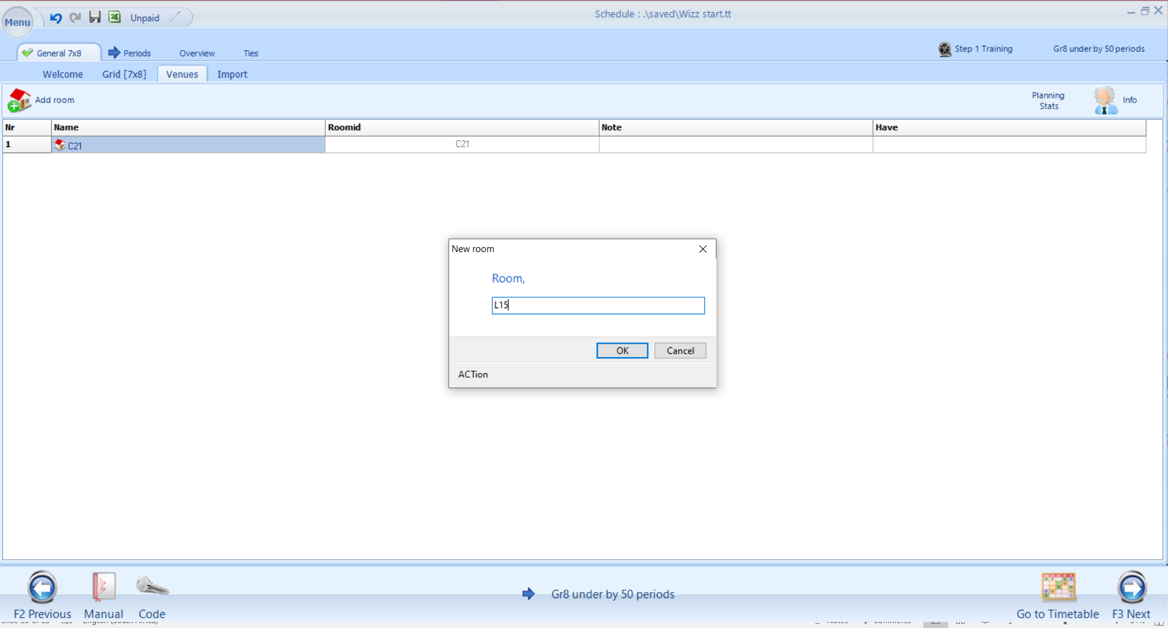
TVET COLLEGES:
BUILDING + FLOOR+ROOM NUMBER A-01-10
BUILDING = A,B,C etc
FLOOR = 00 (ground floor), 01 (1st floor), 02 – (2nd floor)
ROOM = 01 – 10 or more
A-01-10
Click on Add room and NAME the room / venue according to the Institution’s policy
BACK TO MAIN MENU

Slide 28
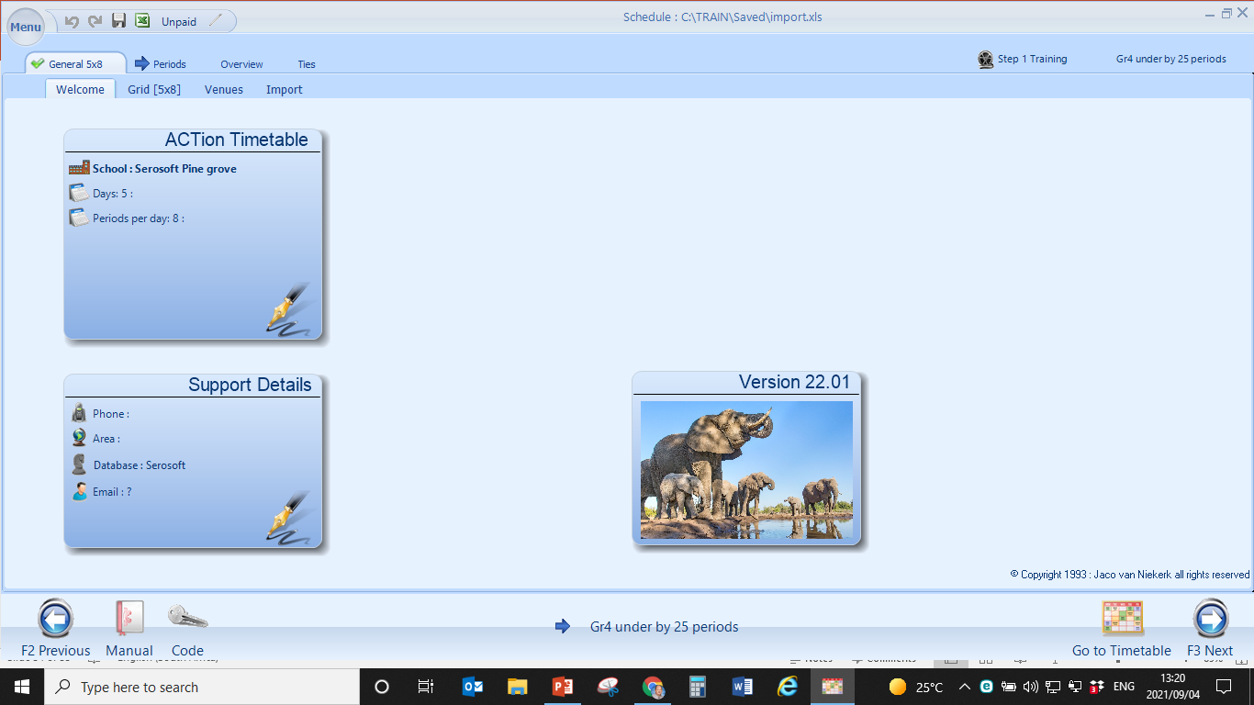
Built in Timetable Alerts
The meaning of the “alert button” is to inform you that you still have outstanding information

Slide 29
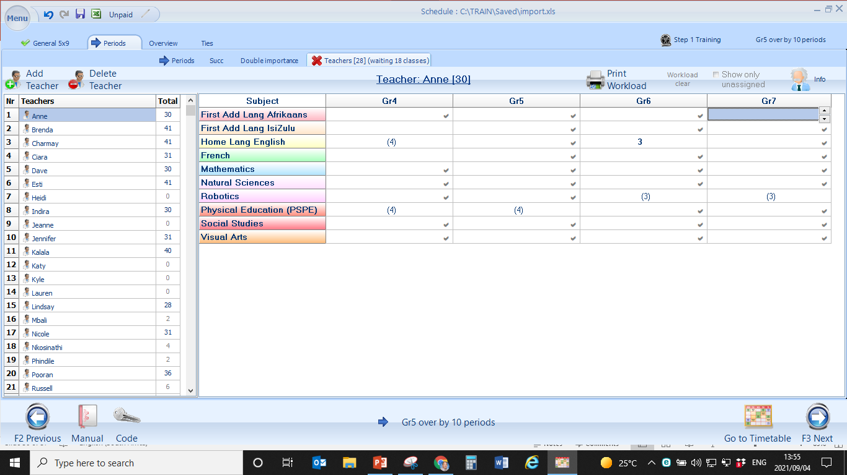
Assigning Subjects: Option 1
Periods Tab > Teachers
The user can click and drag a subject allocation to a teacher

Slide 30
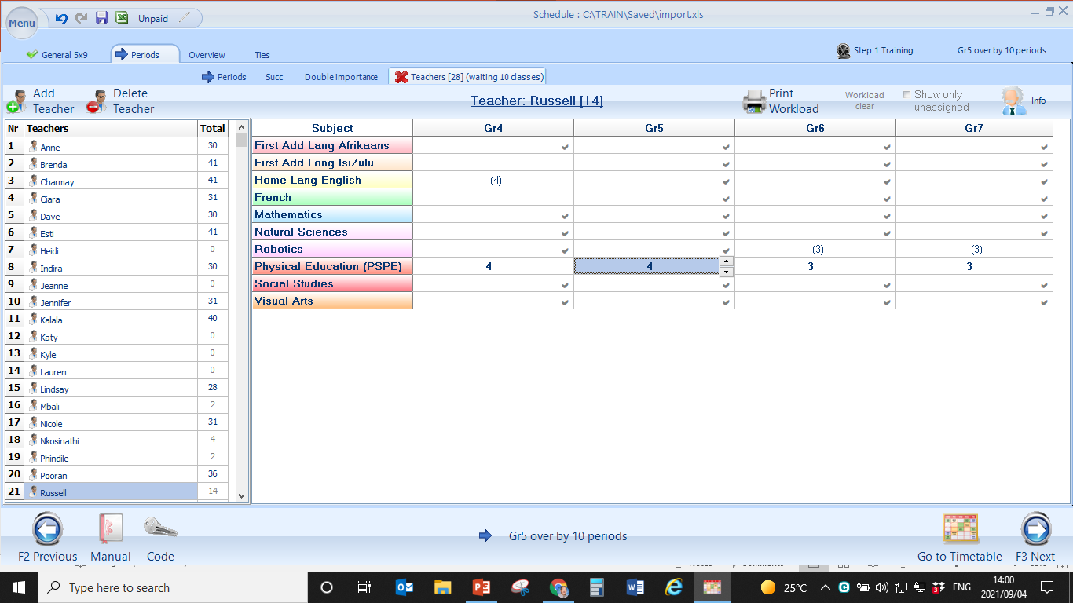
Subjects/courses in brackets are not allocated
These subjects are allocated
The subject is now allocated to a teacher

Slide 31
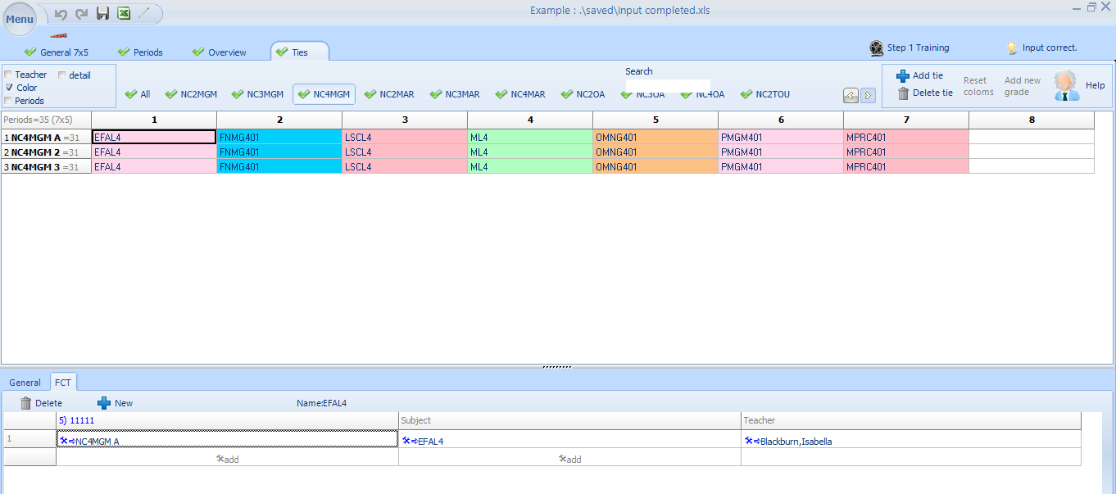
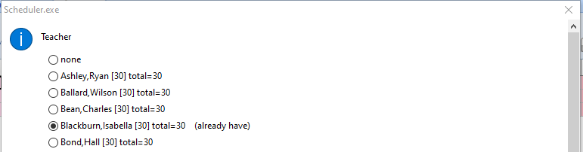
Assigning Subjects: Option 2
Ties Tab
2. This Dialogue window will open. Select teacher and click OK or ENTER
1. Double click in the Teacher Block

Slide 32
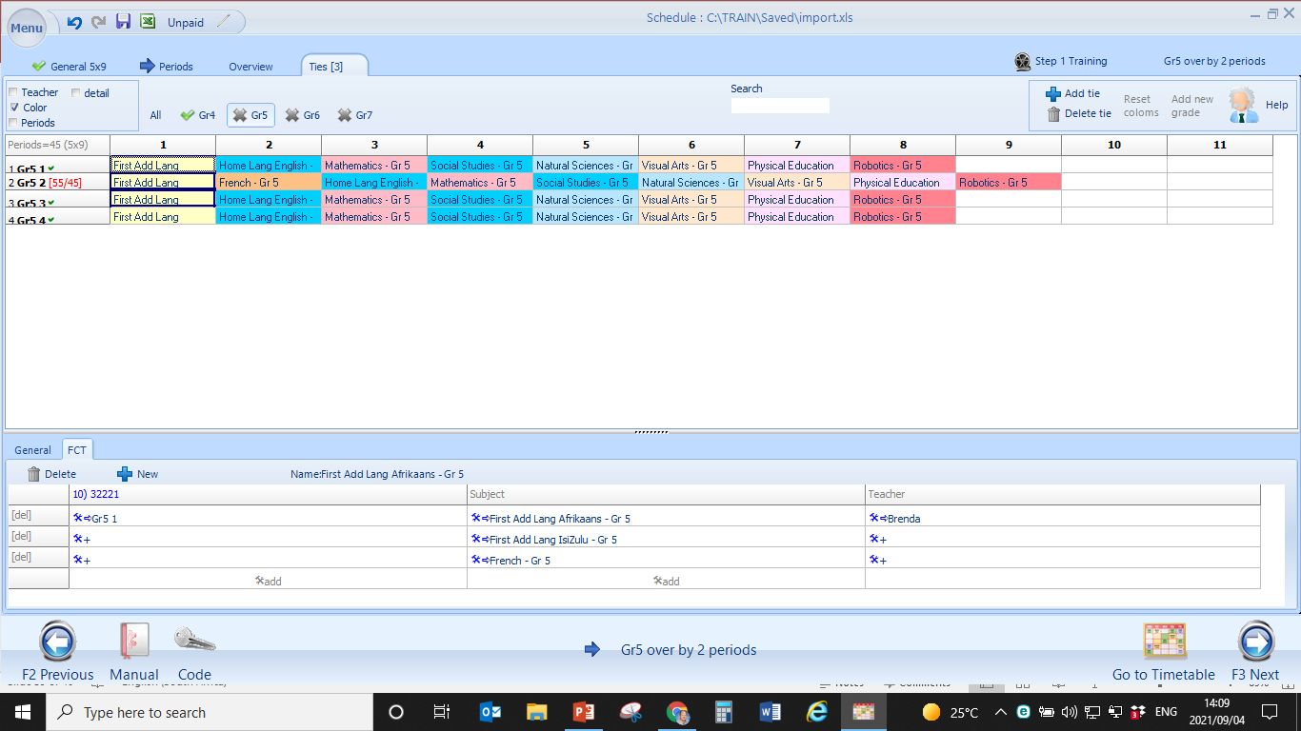
Complete
Incomplete
Too many subjects in this tie
These subjects are not allocated
BACK TO MAIN MENU

Slide 33
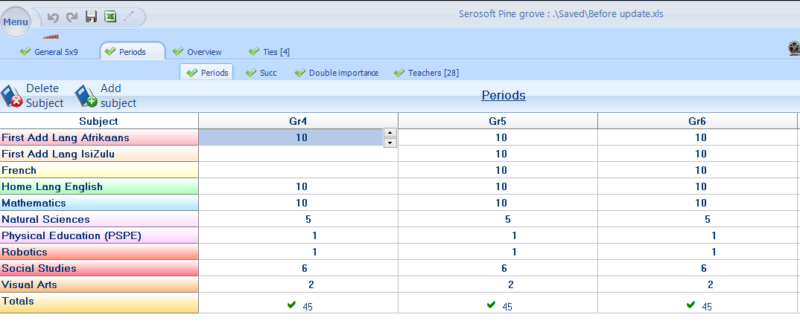
Working with Ties and Special Combinations: Things to remember
Very Important: When working with TIES or special combinations, the user can only join subjects with the SAME NUMBER of periods together. These subjects can join comfortably without any errors. Subjects with a 10 period and 6 period allocation is not recommended.
Subjects joined in ties must have equal number of periods

Slide 34
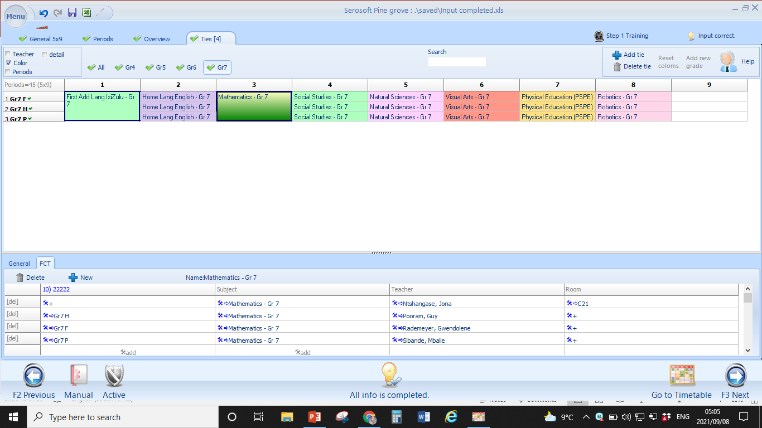
Assigning 3 or more classes to 4 of more teachers concurrently
3 Classes concurrently in eg. Mathematics
3 Classes and 4 teachers
Assign the same subject 4 times to 4 teachers
You can add venues
BACK TO MAIN MENU

Slide 35
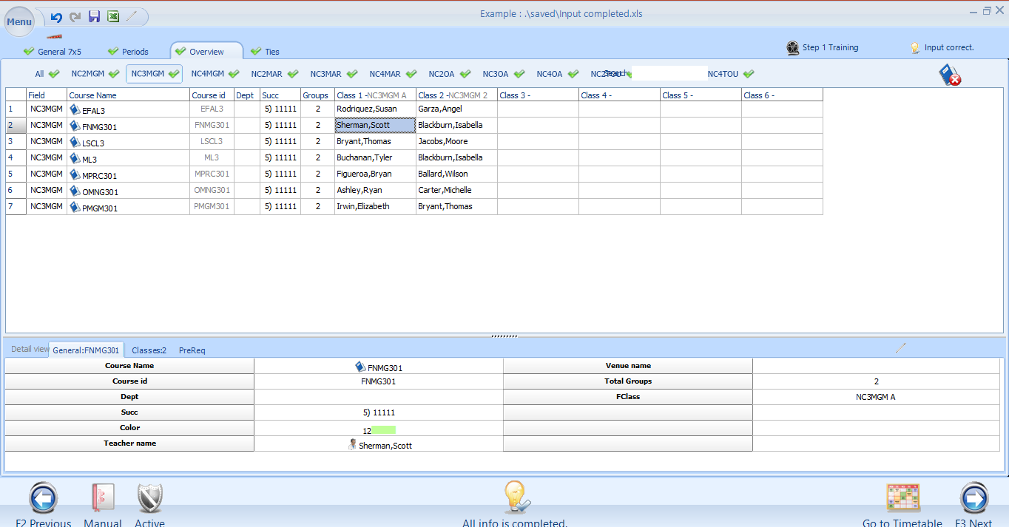
Assigning Subjects: Option 3
Overview Tab
1. Overview Tab – Select course
2. Double click on Teacher’s Name
3. This Dialogue window will open. Select teacher and click OK or ENTER

Slide 36
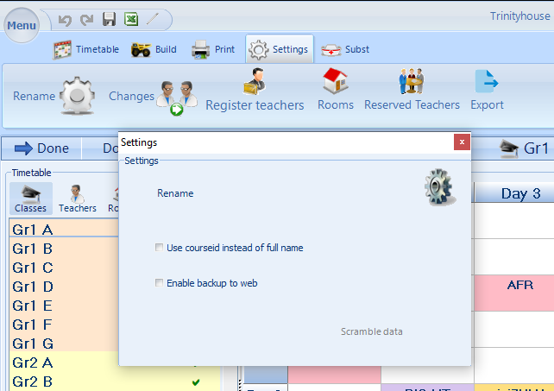
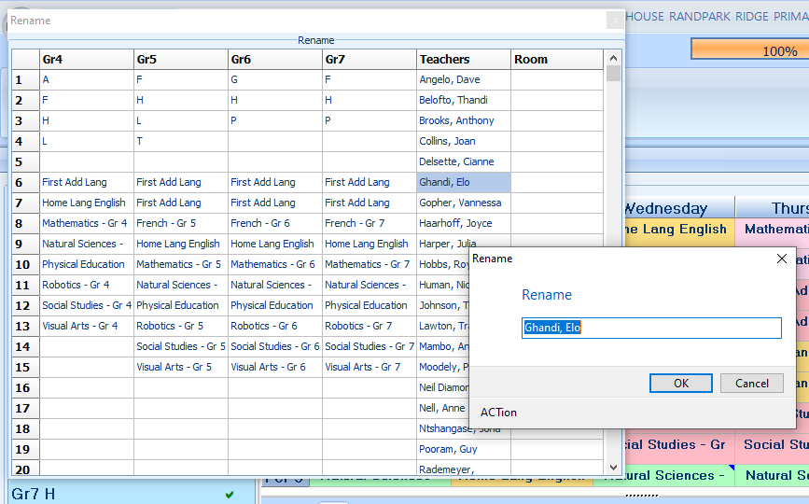
Mid-year renaming of Subjects / Names / Classes
1. In Timetable: Go to Settings
2. Select Rename
3. Select Rename on the Dialogue box
4. Double Click the Subject / Name / Class you would like to rename and type the Subject/ Name / Class in the Dialogue box. Click OK

Slide 37
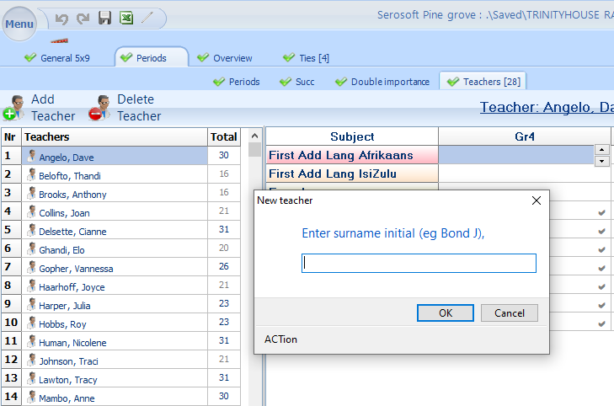
Mid-year teacher replacement and reallocation of subjects
1. Go back to Input and Select Periods
2. Select the Teachers Tab
3. Click on Add teacher
(The user can also Delete teachers)
4. Type Suname, Name of new Teacher
5. Allocate subjects to the new teacher under the Ties menu and compile new timetable
BACK TO MAIN MENU

Slide 38
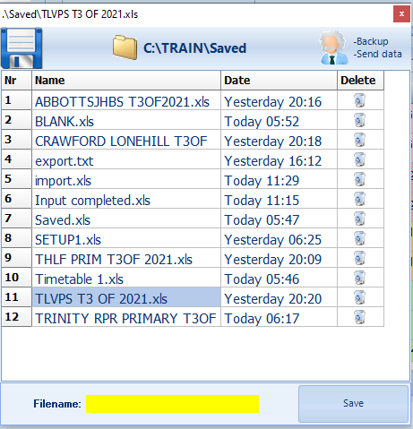
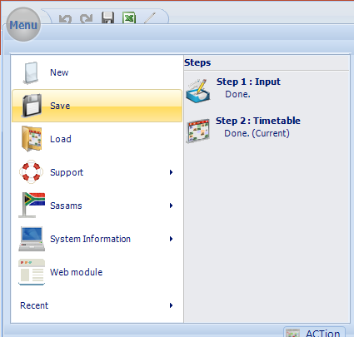
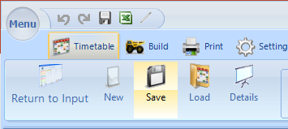
Looking after data: How to Save
Option 1
Click on Menu
Click on Save
Option 1
Click on the Save Icon
Enter the File name and click on SAVE

Slide 39
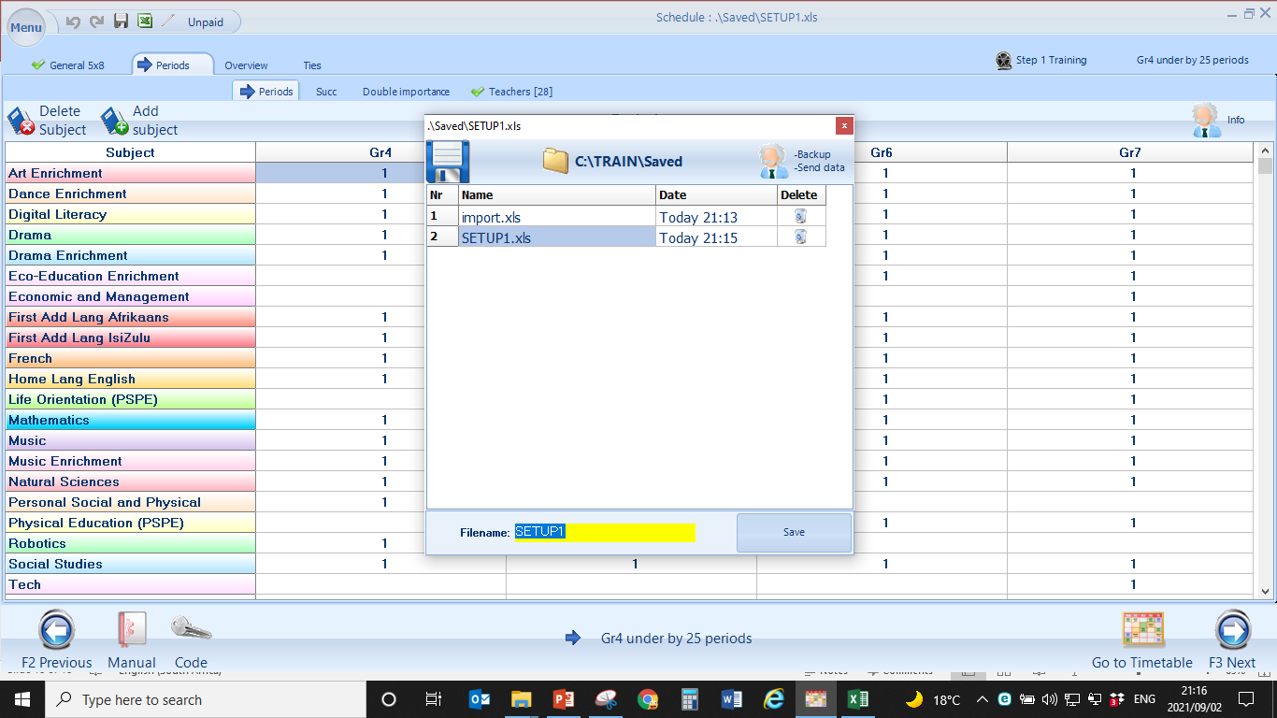
Click on MENU, select SAVE and type in SETUP1

Slide 40
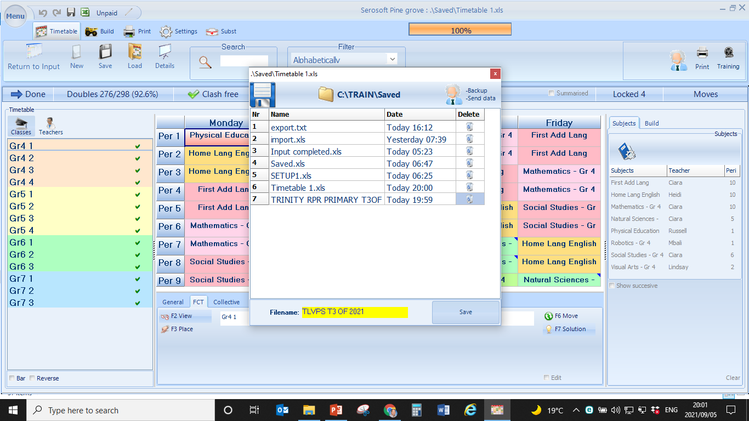
ACTion recommends that the final timetable gets saved with a Campus Name and a Term date

Slide 41
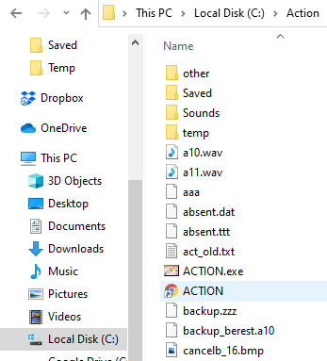
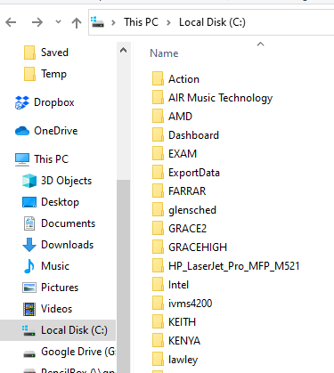
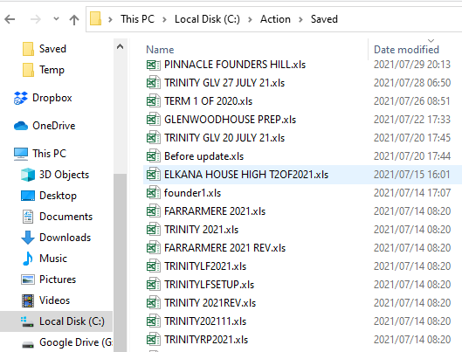
Looking after data: How to keep a backup file
1.
In Local Disk (C) Double click Action
3.
Copy the latest Timetable in Excel format and keep in a safe place
2.
Double click on the Action Folder
BACK TO MAIN MENU

Slide 42
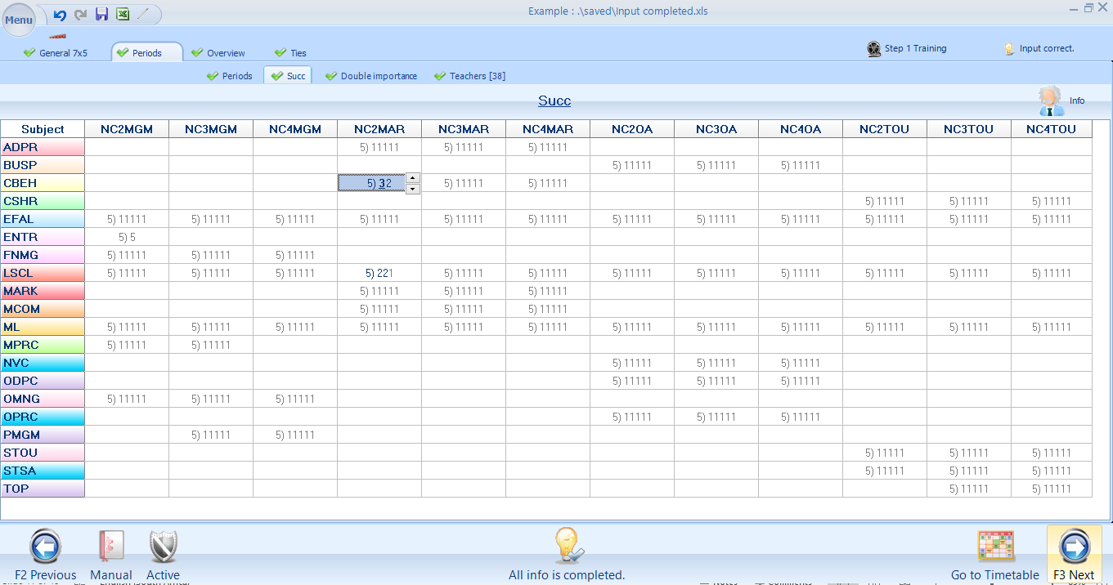
Successive Periods
5)32 = One day with 3 periods and another day with 2 periods
5)11111 = 1 period per day over 5 days
5)221 = double period + double period and single over 3 days
5)5 = 5 periods gets placed on one day

Slide 43
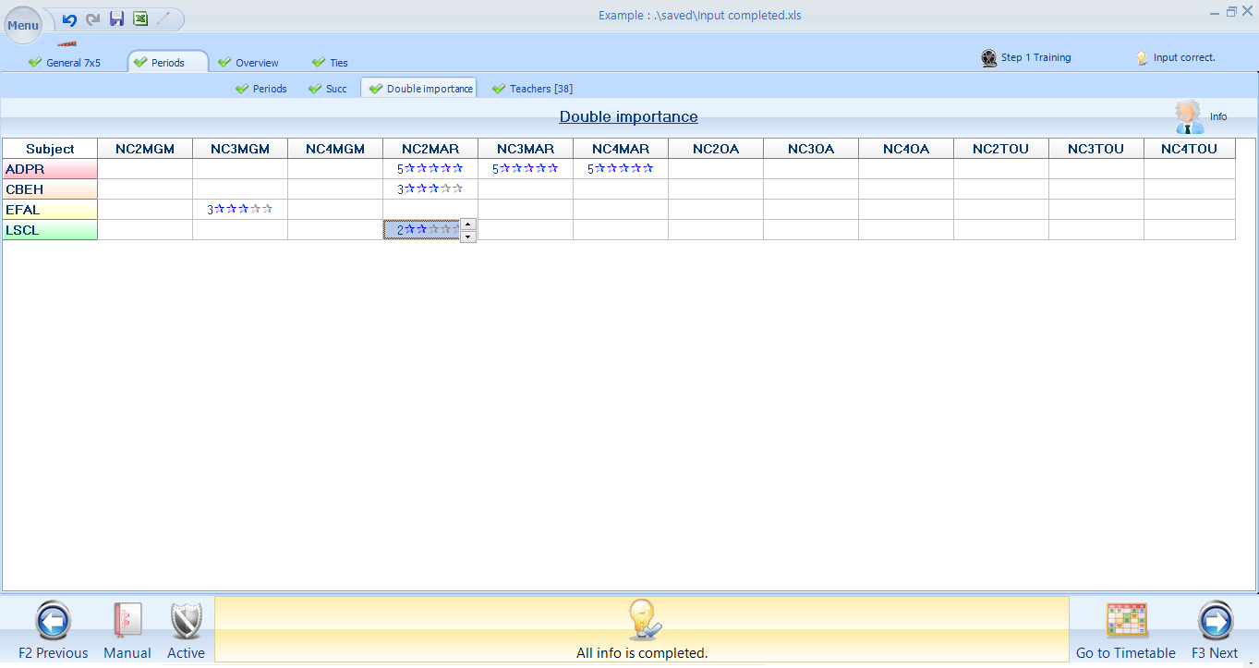
1 = Minimum number of double periods
2 = Some double periods
3 = Acceptable level of doubles
4 = Almost all double periods
5 = Priority – maximum number of double periods

Slide 44
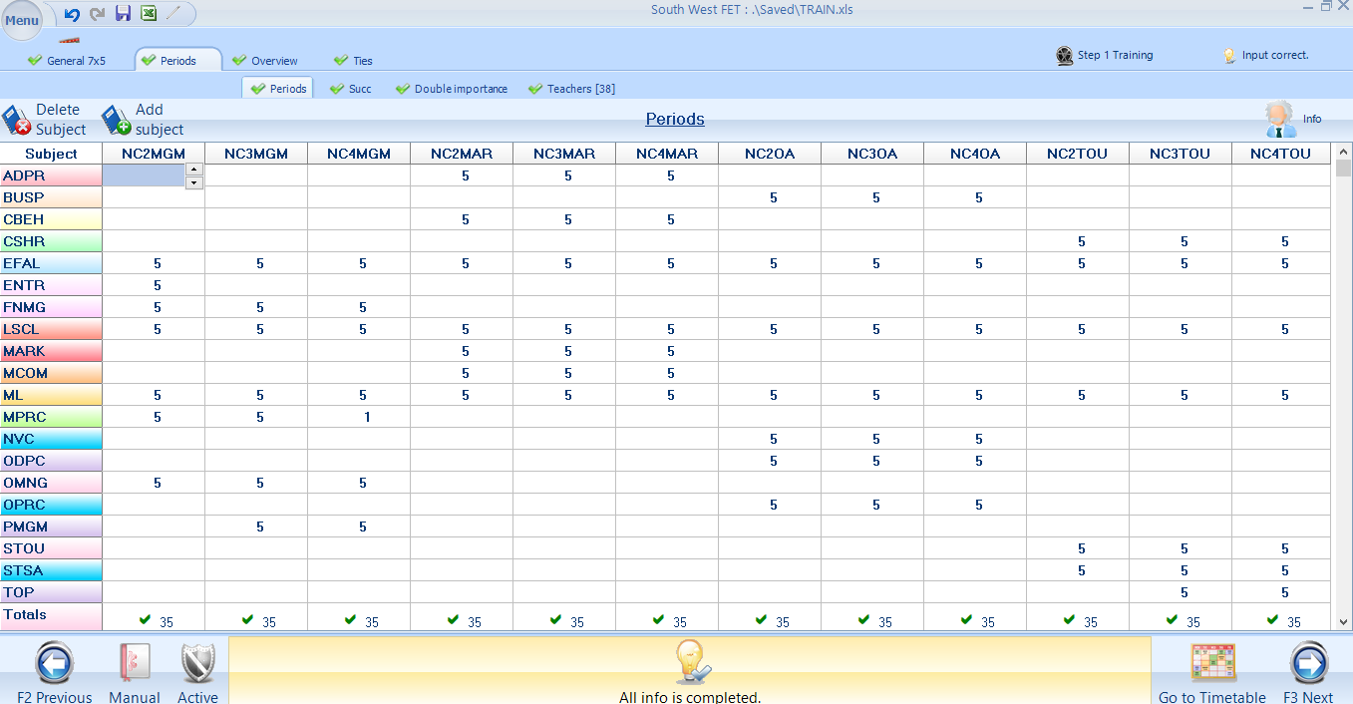
Compilation of Timetable
Once all information is correct in the input, click on the Timetable Icon and proceed to the Timetable

Slide 45
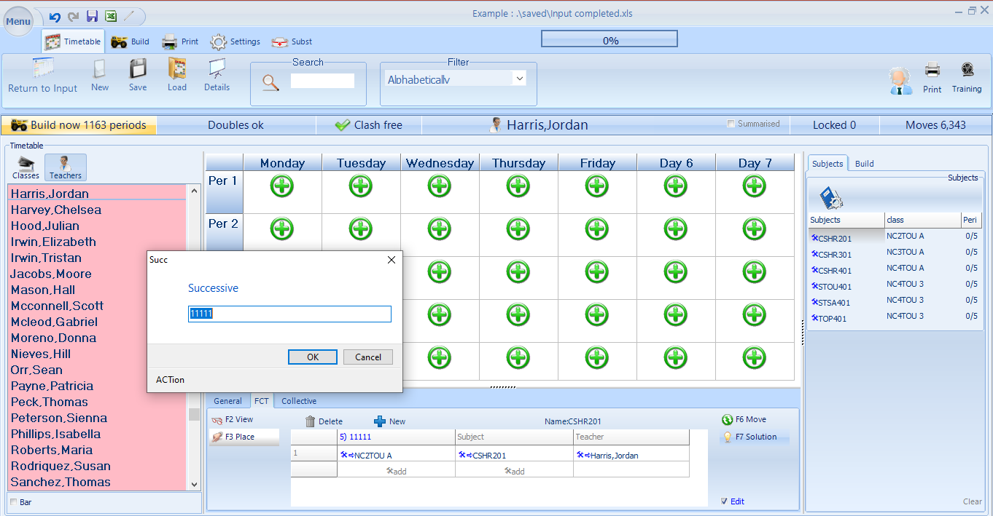
Edit period succession in the timetable
1. Click on the subject
3. Make sure you are working with the correct subject
4. Double click on the periods and edit
2. Click on Edit

Slide 46
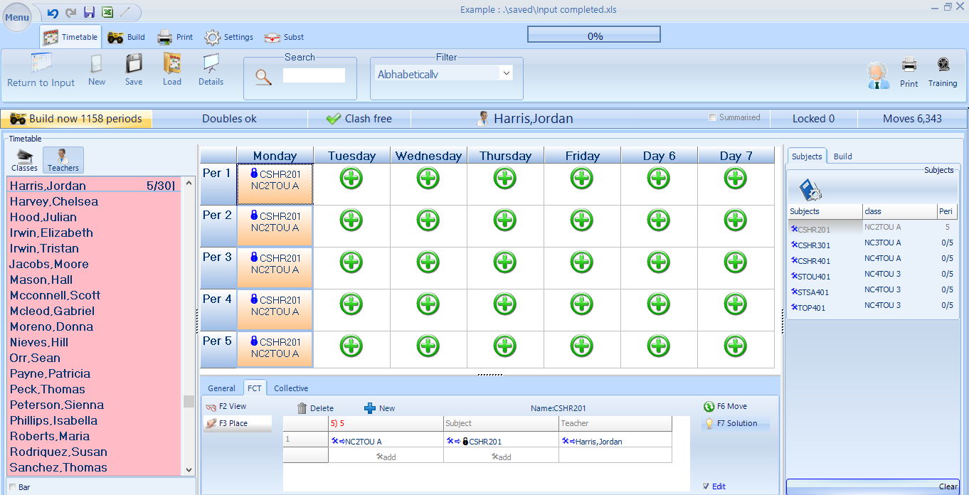
Placing all periods of a specific subject on 1 day
Double click and place the subject in succession
The successive option should be changed to a 5

Slide 47

Blocking Admin or other periods
1. Select the teacher’s name
2.Double click on the desired block
3. A Dialogue box will open
4. Click on Reserve
5. Choose and option or Type in a new name

Slide 48


Build a Timetable
Click on the Build Tab and then select Build Option
Select the Build Speed
Fast – Quick compilation
Slow – to ensure maximum number of doubles

Slide 49

Restore Doubles
Fast: Will restore doubles to an acceptable level
Very, Very Slow – Maximum number of doubles

Slide 50

Print the Timetable
Print the Timetable
Classes, Teachers, Rooms, Substitution, Summarised, Workload

Slide 51

Print options available:
PDF, Excel or Printer

Slide 52

How to make an ITS export file
Once your timetable is done, click on File Save.
Now click on
Click on SETTINGS
Click on Save

Slide 53

Export Timetable to ITS
Once your timetable is done, click on ITS Export.

Slide 54

Click on CSV.

Slide 55

A Notepad Document will open

Slide 56

Click on Save As and save the File with your Campus name the Faculty and the Term.
Click Save and the file is ready for the MIS officer

Slide 57

Export to Excel
Click on ITS Export
Click on Excel
Click OK

Slide 58

Export to Excel
Paste in Excel Spreadsheet
Click on Save

